Slide 1

ANALYSIS OF CYCLONE TRACK DATA DURING 2018-2022
Swarnamoy Ghosh Debargho Chatterjee Ganguly
(PG/05/MSTSTDS/2023/002) (PG/05/MSTSTDS/2023/004)
M.Sc. Tech(Statistics & Data Science)
Adamas University, Kolkata
Under the guidance of
Dr. Sudip Jana
Assistant Professor
Department Of Mathematics
Adamas University, Kolkata

Slide 2
Outline
Introduction
Dataset Overview
Data Preprocessing
Key Findings (Graphs and Statistics)
Cyclone Trends (Annual and Seasonal Insights)
Conclusions and Future Work

Slide 3
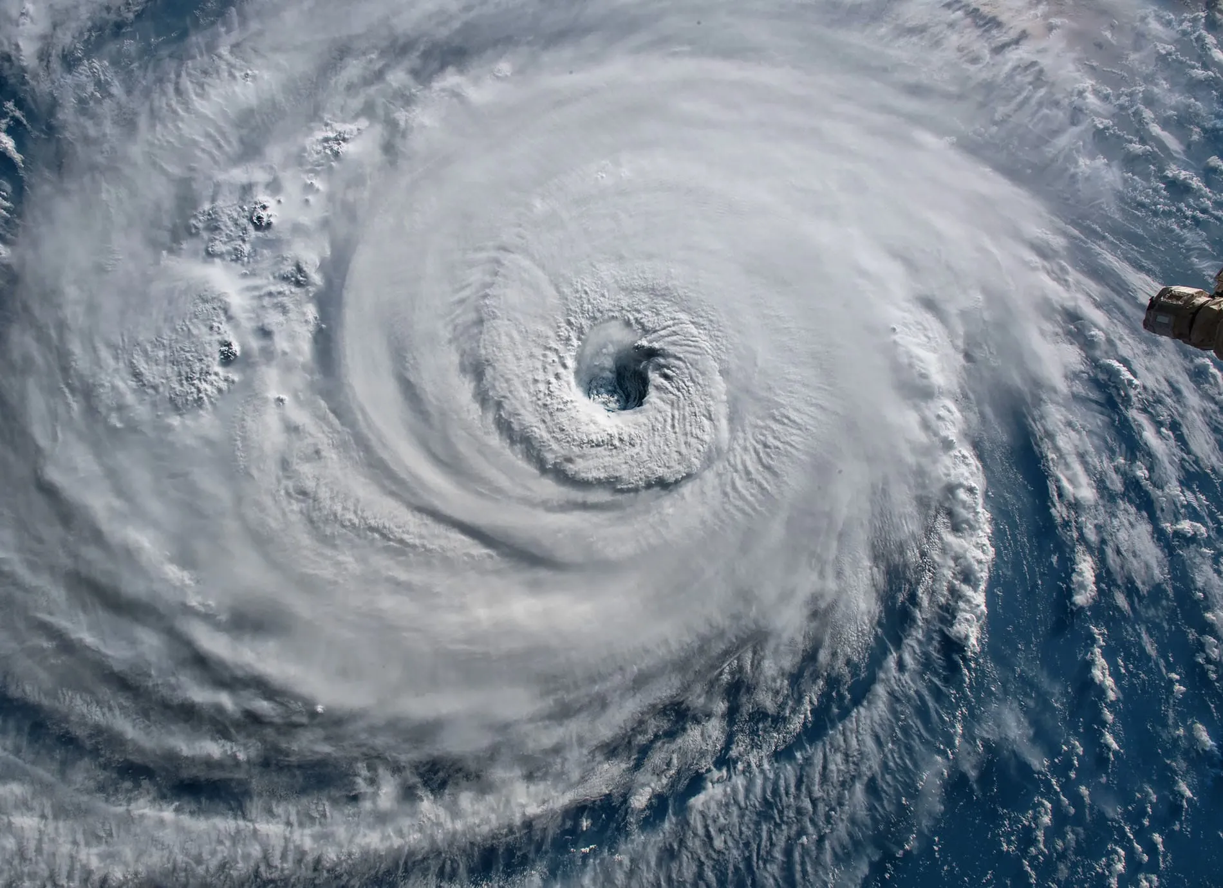
Introduction

Slide 4
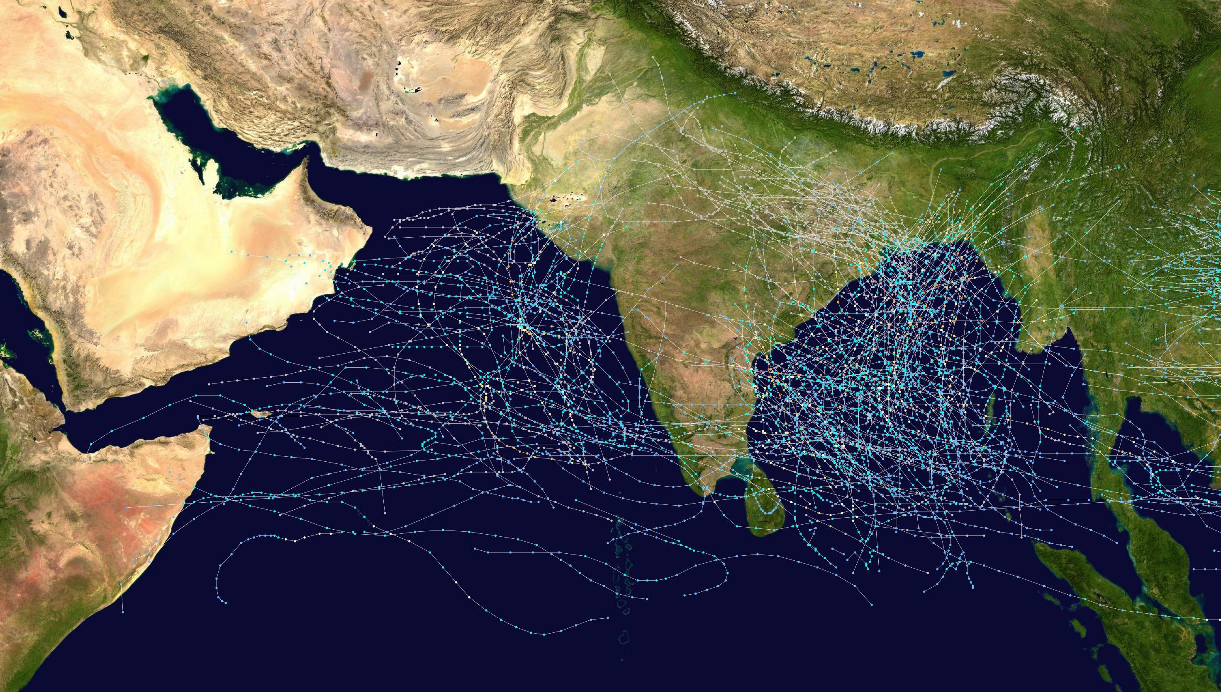
Introduction

Slide 5
Introduction
Objective: Analyze cyclone data from 2018 to 2022 to uncover patterns and trends.
Key Focus Areas:
Wind speed, central pressure, and cyclone grades.
Seasonal and annual variations.
Geographical distribution of cyclones.
Purpose:
Identify trends and changes in cyclone activity.
Explore relationships between meteorological parameters.
Provide insights to enhance prediction models and disaster preparedness.
Significance: Establish a foundation for further studies in meteorology and disaster management.

Slide 6
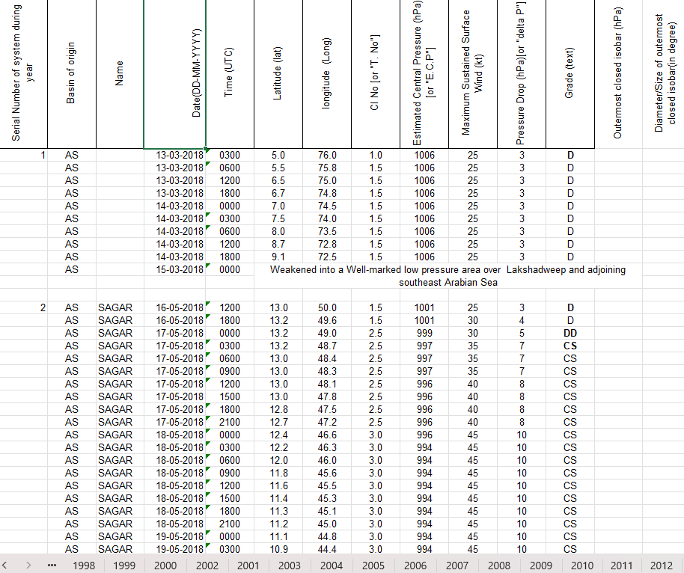
Dataset Overview
Sample of the Original Excel data
Excel Data

Slide 7
Dataset Preprocessing
1. Selection of Data for Analysis
A subset of data from the last five years (2018–2023) was selected as a representative sample for the exploratory data analysis. This timeframe was chosen to identify recent trends and patterns.
2. Addition of a New Column: "O/L"
A new column named "O/L" was introduced to the dataset. This column classifies cyclone data into two categories:
O: Cyclones located over the ocean.
L: Cyclones located over land.
3. Imputation of Missing Values
Missing or null values in critical columns such as Serial Number, Date, and Name were imputed. This step ensures the completeness of the dataset for analysis.
4. Removal of Non-Numeric Rows
Rows containing textual descriptions (e.g., landfall events or weakening of a cyclone) were identified and removed. This step ensures that only relevant numerical data is retained for statistical and graphical analyses.
5. Dataframe Creation
The cleaned and preprocessed data was converted into a structured DataFrame format. This transformation facilitates efficient analysis and visualization in subsequent steps.

Slide 8
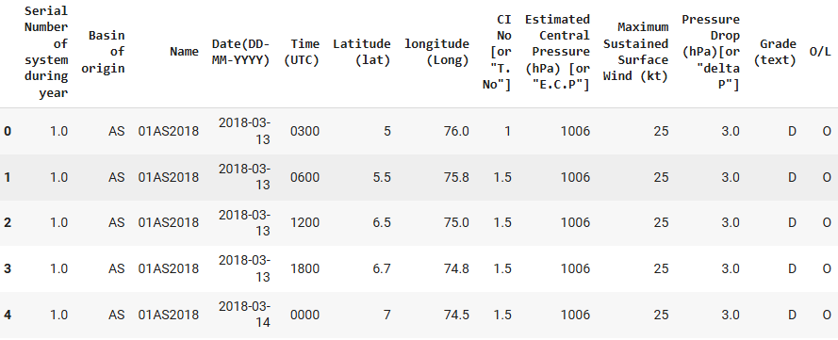
Dataset Overview
Converted into Python Data frame

Slide 9
Dataset Overview
Serial Number of System During Year
A unique identifier assigned to each cyclone within a specific year.
Basin of Origin
The region where the cyclone originated (e.g., Bay of Bengal, Arabian Sea).
Name
The official name of the cyclone, assigned by meteorological agencies.
Date (DD-MM-YYYY)
The specific date when the cyclone was recorded.
Time (UTC)
The time (in Coordinated Universal Time) when the observation was made.
Latitude (lat)
The geographical latitude indicating the cyclone's location.
Longitude (long)
The geographical longitude indicating the cyclone's location.

Slide 10
Dataset Overview
CI No [or "T. No"]
Cyclone Intensity Number, indicating the cyclone's intensity at the time of observation.
Estimated Central Pressure (hPa) [or "E.C.P."]
The central atmospheric pressure of the cyclone, measured in hectopascals (hPa).
Maximum Sustained Surface Wind (kt)
The maximum wind speed near the cyclone's center, measured in knots (kt).
Pressure Drop (hPa) [or "ΔP"]
The difference between the ambient pressure and the cyclone's central pressure.
Grade (text)
The classification of the cyclone based on its intensity (e.g., Depression, Cyclonic Storm, Severe Cyclonic Storm).
O/L (Ocean/Land)
Indicates whether the cyclone is over the ocean (O) or land (L).

Slide 11
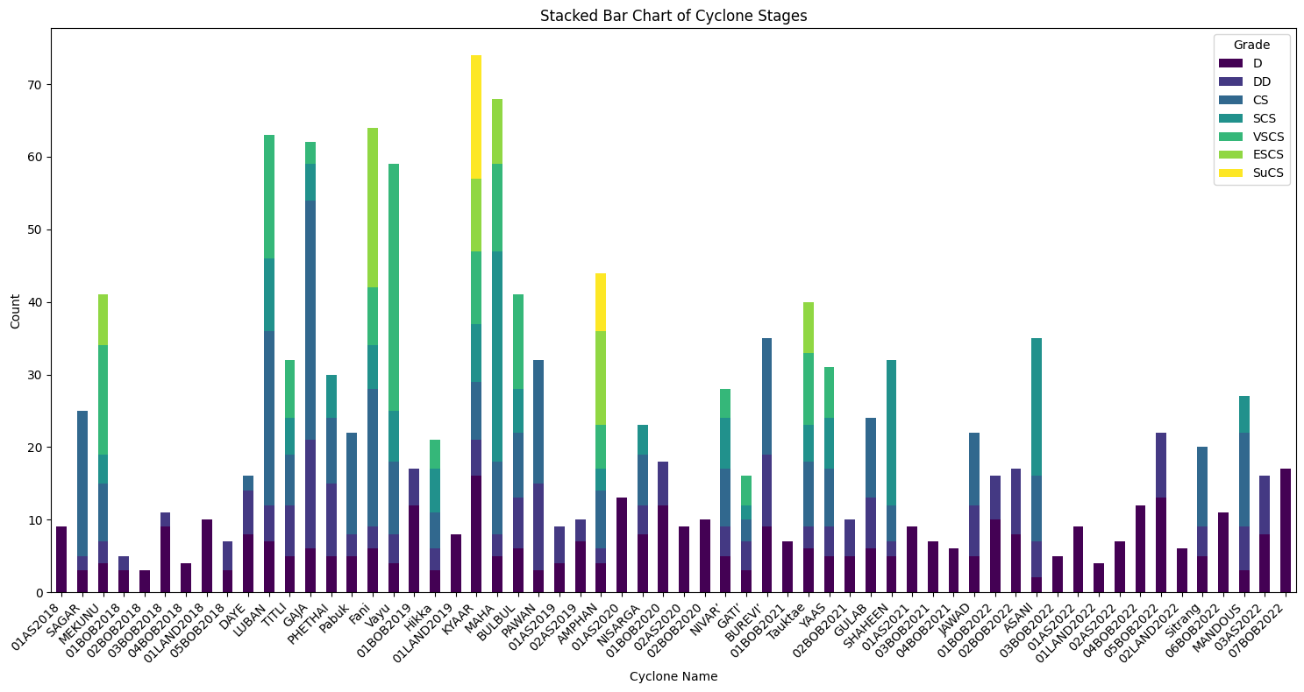
Key Findings
Stacked Bar Chart of Cyclonic Stages of 2018-22

Slide 12
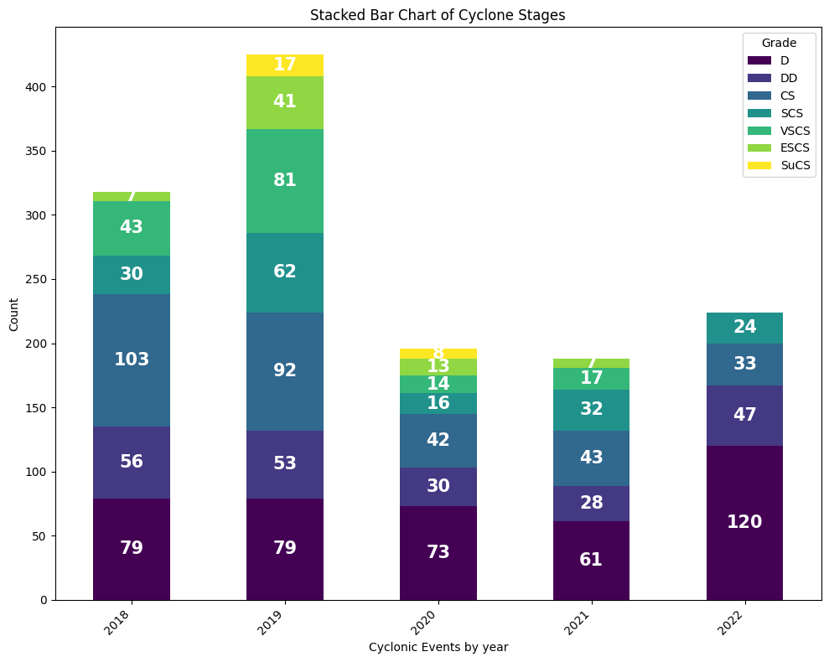
Key Findings(Based on Years)
Grade Counts of Cyclonic Events In Each Year

Slide 13
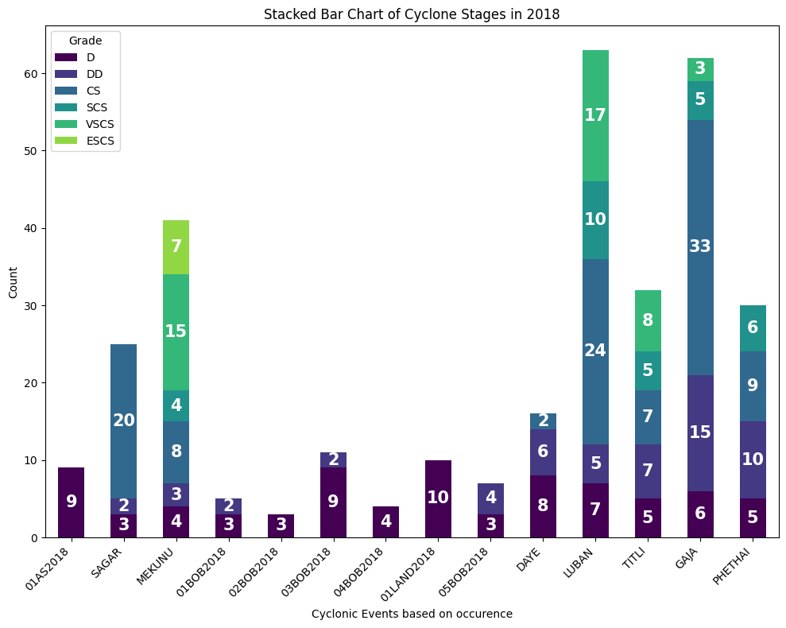
Key Findings
Grade Counts of Cyclonic Events In Year 2018

Slide 14
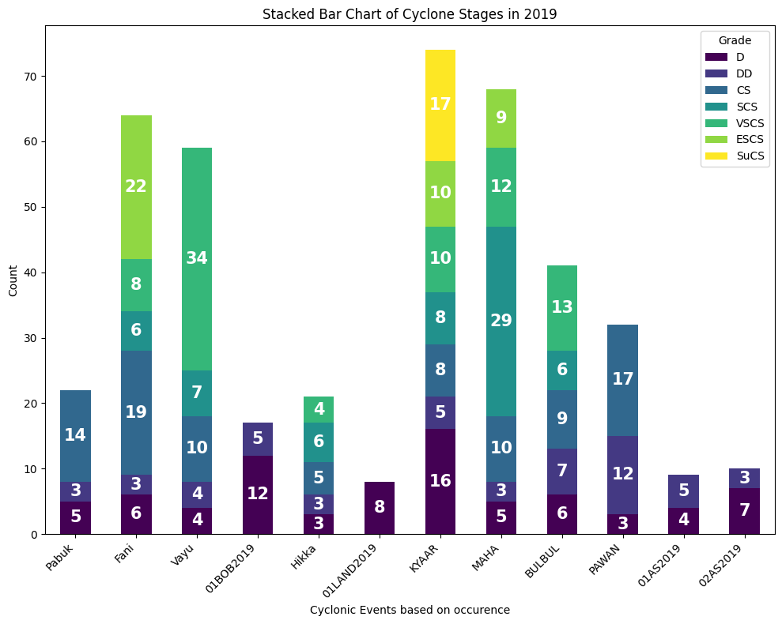
Key Findings
Grade Counts of Cyclonic Events In Year 2019

Slide 15
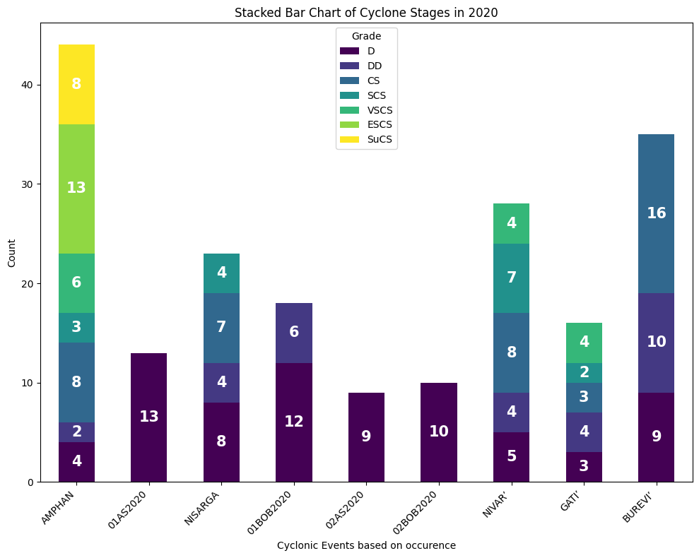
Key Findings
Grade Counts of Cyclonic Events In Year 2020

Slide 16
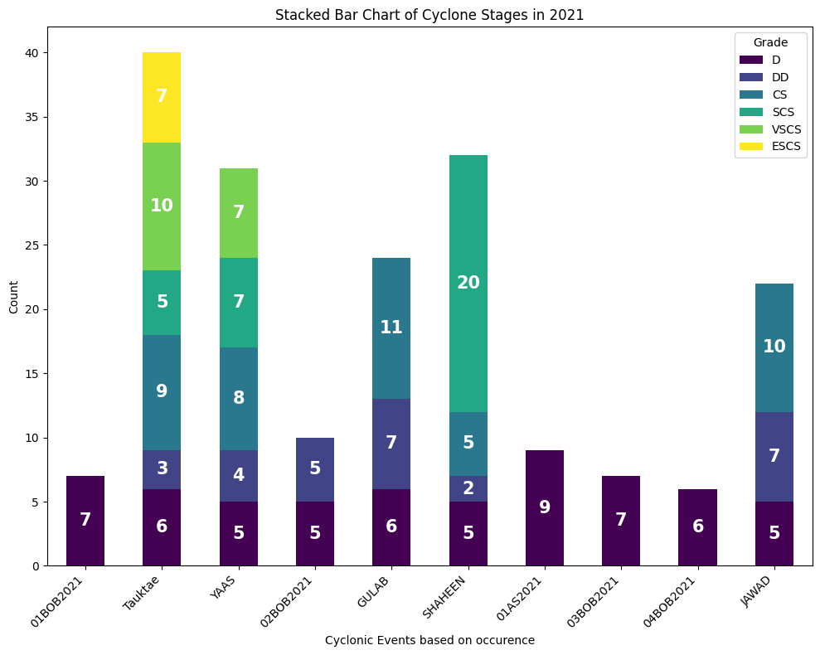
Key Findings
Grade Counts of Cyclonic Events In Year 2021

Slide 17
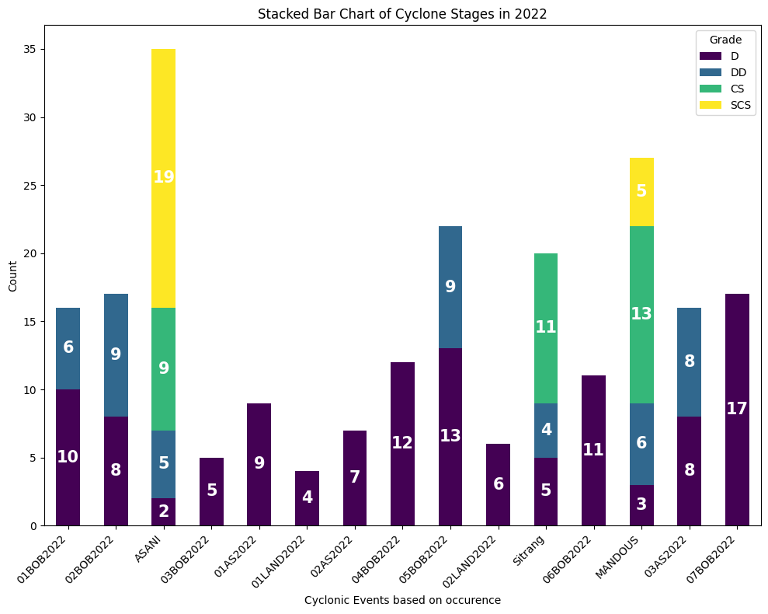
Key Findings
Grade Counts of Cyclonic Events In Year 2022

Slide 18
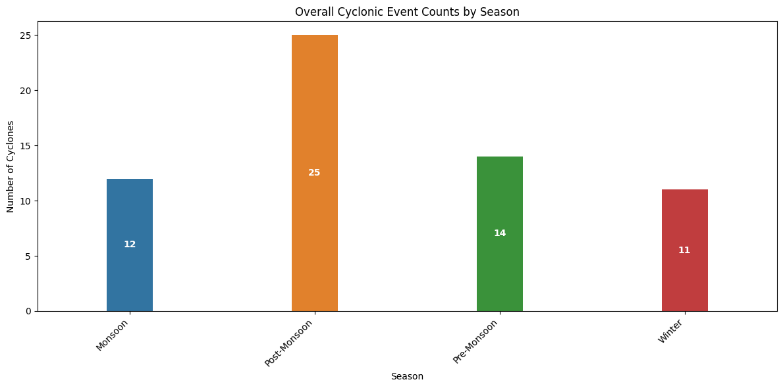
Key Findings(Based on Season)
Overall Cyclonic Events Counts By Season

Slide 19
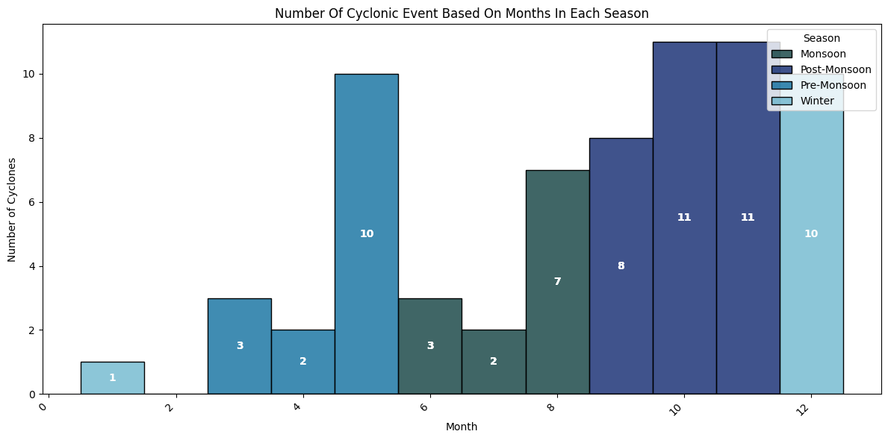
Key Findings
No. of Cyclonic Events Based On Season

Slide 20
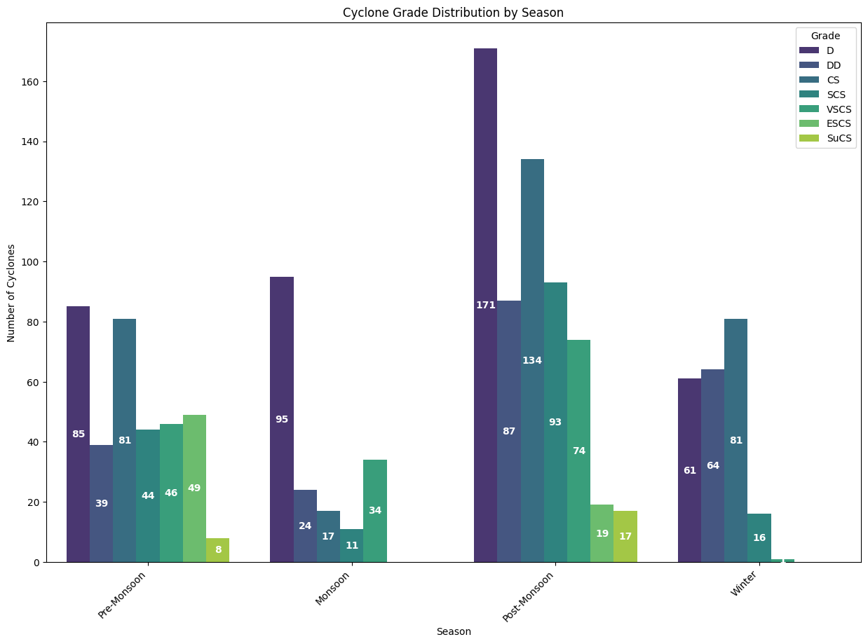
Key Findings
Distribution of Cyclonic Grades Based On Season

Slide 21
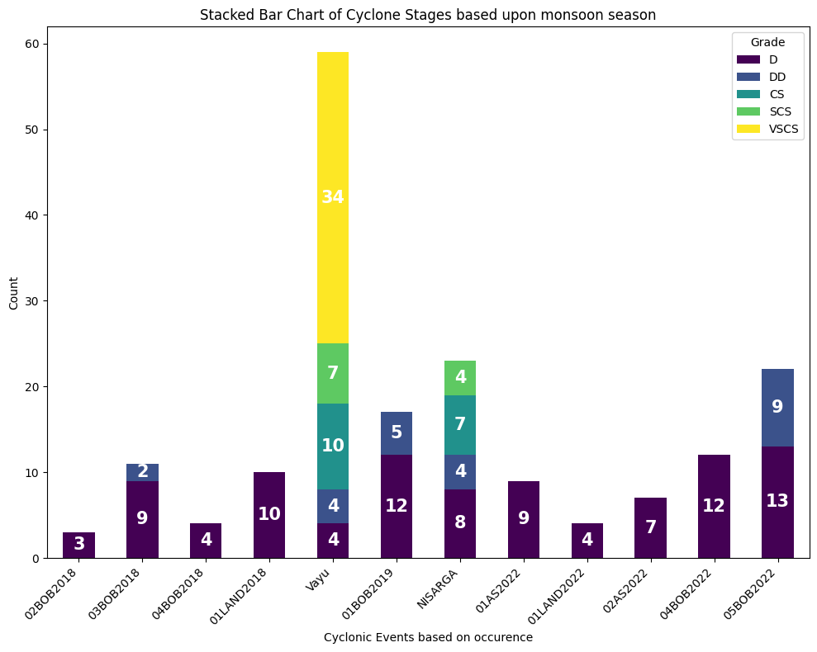
Key Findings
Bar Chart of All Cyclonic Events on Monsoon Season

Slide 22
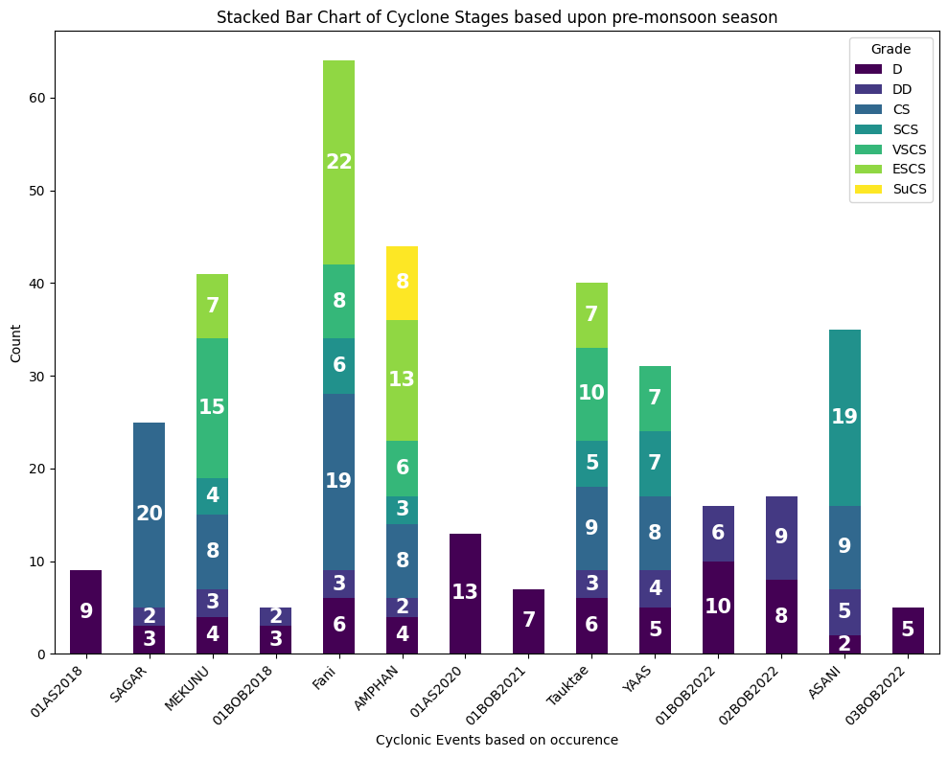
Key Findings
Bar Chart of All Cyclonic Events on Pre-Monsoon Season

Slide 23
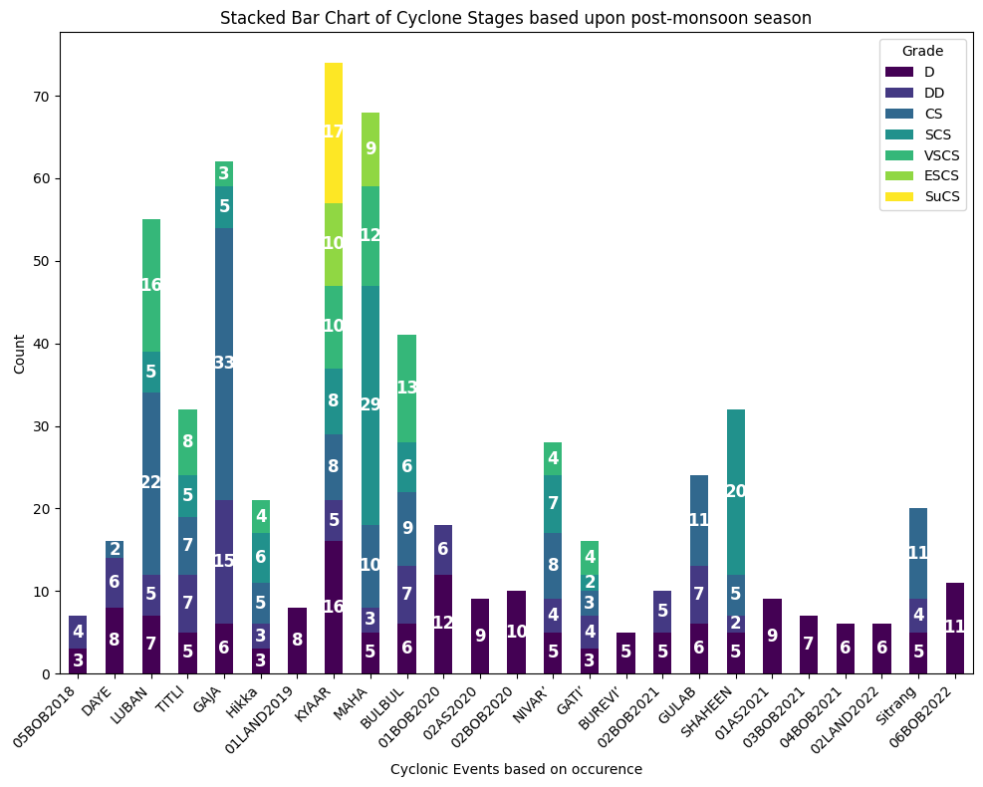
Key Findings
Bar Chart of All Cyclonic Events in Post-Monsoon Season

Slide 24
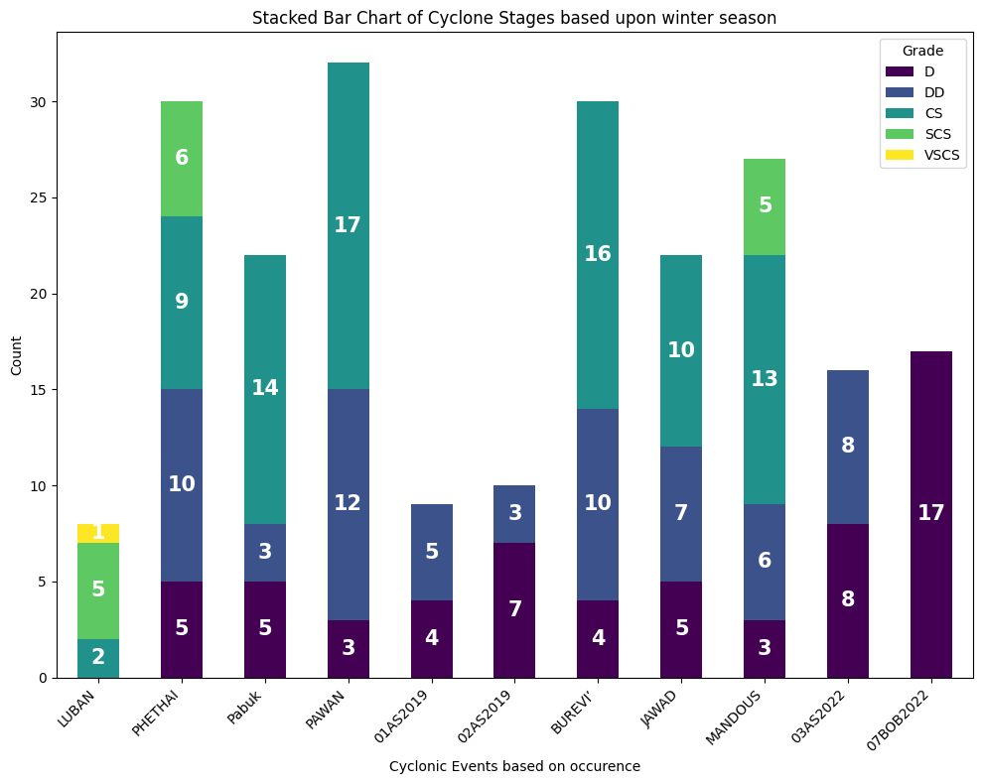
Key Findings
Bar Chart of All Cyclonic Events on Winter Season

Slide 25
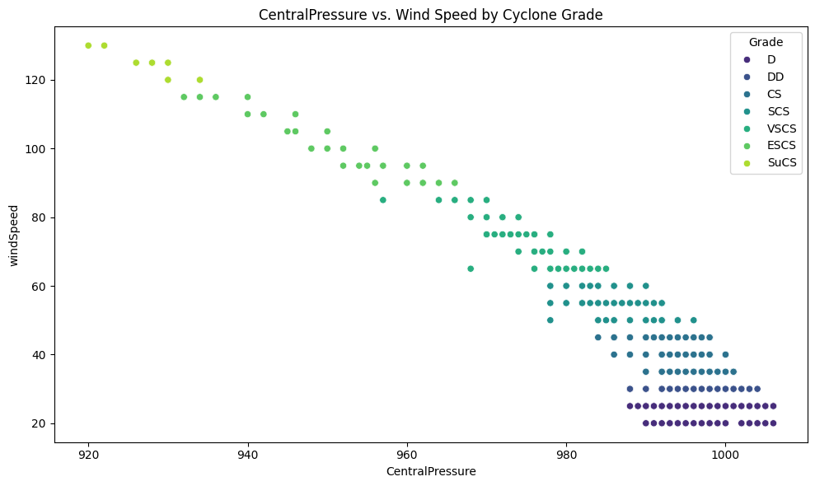
Key Findings
Notes:
Weak stage of cyclonic activity
The wind speed increase with the decrease in Pressure. When the pressure drop is small then wind speed may depend on some other parameters
The spread explains the decrease in wind speed , here the wind speed is affected by several other factors

Slide 26
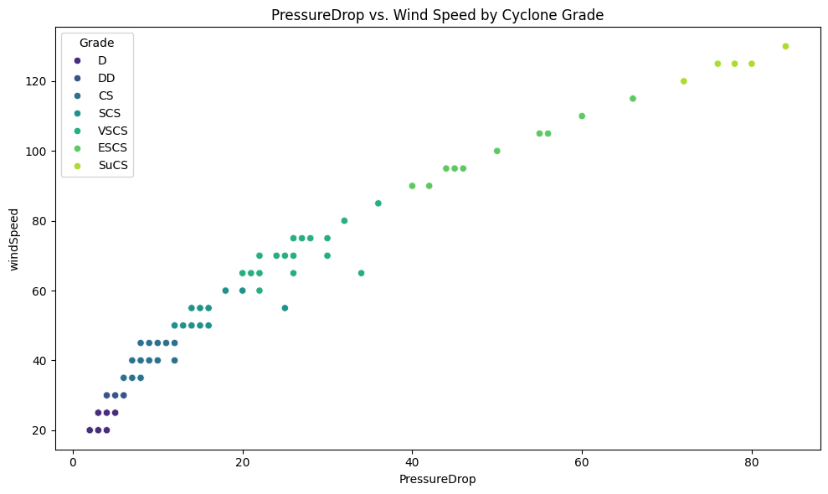
Key Findings

Slide 27
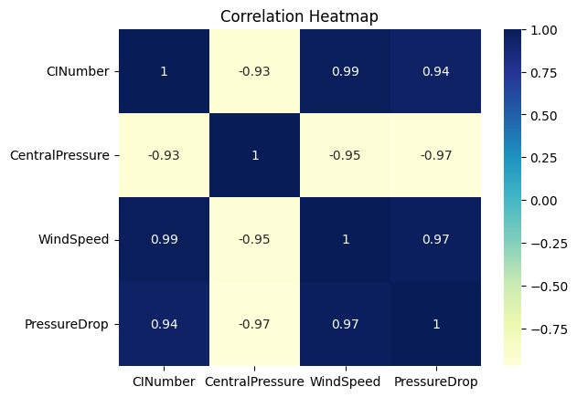
Key Findings
Correlation heatmap for multivariate analysis

Slide 28
conclusion
1. Depressions and Cyclone Formation
While many depressions form annually, only a small fraction intensifies into cyclonic storms. This highlights the variability in atmospheric and oceanic conditions required for cyclone development.
2. Regional Differences in Cyclone Activity
The Bay of Bengal consistently records a higher number of cyclones compared to the Arabian Sea. This disparity is due to factors such as warmer sea surface temperatures and favorable wind patterns in the Bay of Bengal.
3. Seasonal Cyclone Trends
The Post-Monsoon season (October to December) witnesses the maximum number of cyclones. This period is marked by conducive conditions for cyclone formation, including reduced wind shear and warmer waters.
4. Cyclone Intensity vs. Duration
The total lifespan of a cyclone does not always correspond to its peak intensity. Factors such as environmental conditions, interaction with land, and ocean heat content influence a cyclone’s intensity.
5. Occurrence of Super Cyclonic Storms (SuCS)
Over the past five years, only two Super Cyclonic Storms (SuCS) have been recorded, underscoring their rarity and the extreme conditions required for their formation.

Slide 29
References
Mondal, M., Biswas, A., Haldar, S., Mandal, S., Bhattacharya, S., & Paul, S. (2022). “Spatio-temporal behaviours of tropical cyclones over the bay of Bengal Basin in last five decades”. Tropical Cyclone Research and Review, 11(1), 1-15.

Slide 30
THANK YOU

